Slide 1
Fundamentals of Machine Learning
Prepared by
Prince Thomas M.E., PhD
Associate Professor

Slide 2
Chapter 4: Unsupervised Learning and Graphical Models
Clustering Methods
K-Means Clustering: Centroid Calculation and Convergence
Hierarchical Clustering: Agglomerative and Divisive Methods
Dimensionality Reduction
Principal Component Analysis (PCA): Eigenvectors and Eigenvalues
Linear Discriminant Analysis (LDA)
Frequent Pattern Mining
Apriori Algorithm and Association Rules
Applications in Market Basket Analysis
Graphical Models
Bayesian Networks
Markov Networks
Hidden Markov Models (HMMs)
States, Transitions, and Observations
Forward Algorithm and Viterbi Algorithm
Applications in Speech Recognition and NLP

Slide 3
Unsupervised learning
It involves analyzing and clustering data without labeled outputs.
It tries to find hidden patterns, structures, or features within the data.
It is primarily used for exploratory data analysis and tasks where the goal is to uncover insights rather than predict labels.
Key Characteristics
No labeled data is provided; only input data is available.
Focuses on understanding data distributions, relationships, and patterns.
Examples include clustering, dimensionality reduction, and anomaly detection.
Major Technique
Clustering
Dimensionality Reduction
Association Rule Mining

Slide 4
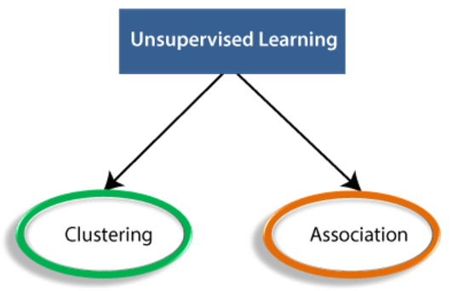
Types of Unsupervised Learning Algorithm
The unsupervised learning algorithm can be further categorized into two types of problems:

Slide 5
Clustering
It is an unsupervised learning technique.
It used to group data points into clusters based on their similarity.
Data points in the same cluster are more similar to each other than to those in other clusters.
Clustering is widely used for exploratory data analysis and pattern recognition.
Clustering Methods
K-Means Clustering
Hierarchical Clustering
DBSCAN (Density-Based Spatial Clustering of Applications with Noise)
Mean-Shift Clustering
Gaussian Mixture Models (GMM)
Applications of Clustering
Customer segmentation
Social network analysis
Market segmentation

Slide 6
K-Means Clustering
K-Means Clustering is a popular unsupervised machine learning algorithm.
It is used to partition a dataset into 𝑘 distinct clusters.
Each cluster is represented by a centroid, and the algorithm iteratively assigns data points to clusters and updates these centroids until convergence.
Steps of Algorithm
Select random K points or centroids. (It can be other from the input dataset).
Assign each data point to their closest centroid, which will form the predefined K clusters.
Calculate the variance and place a new centroid of each cluster.
Repeat the third steps, which means reassign each datapoint to the new closest centroid of each cluster.
If any reassignment occurs, then go to step-4 else go to FINISH.
The model is ready.

Slide 7
Centroid in K-Means Clustering
The centroid is the central point of a cluster in K-Means Clustering.
It is a representative "average" position for all the data points in a cluster.
The algorithm uses centroids to determine which data points belong to which cluster and updates their positions iteratively for better clustering.
Definition
A centroid is the geometric center of a cluster, calculated as the mean of all data points within the cluster.
Convergence in K-Means occurs when the algorithm stops updating centroids or cluster assignments. This happens when the clusters stabilize, meaning the centroids no longer change significantly
Manhattan and Euclidean distance are used to find the distance between the two data point.

Slide 8
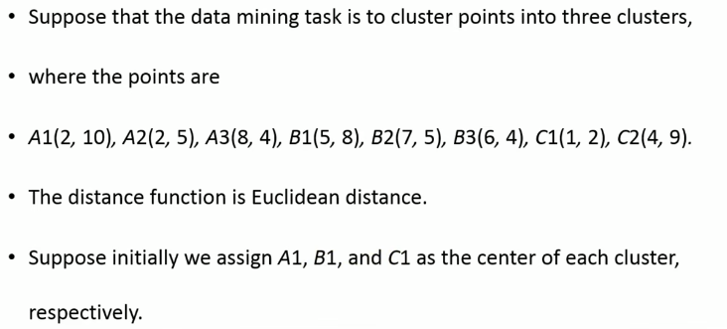
Example:

Slide 9
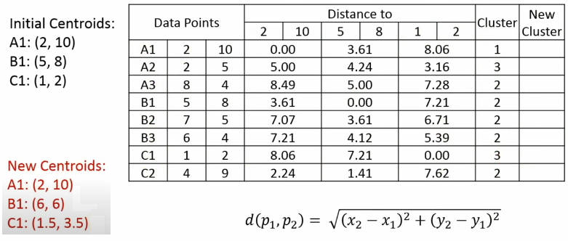

Slide 10
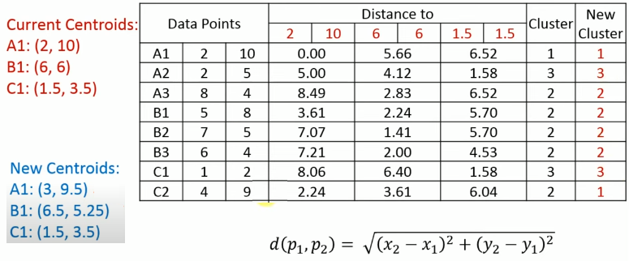

Slide 11
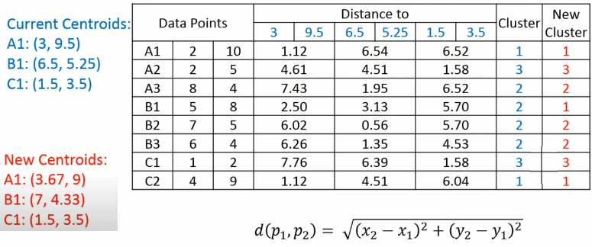

Slide 12
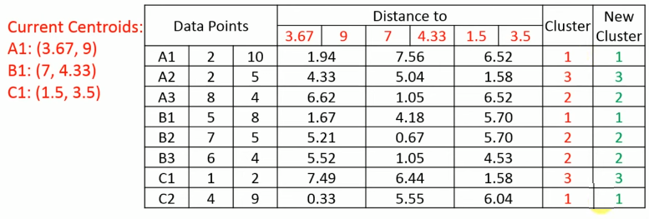
Final clusters are: {A1,B1,C2}, {A3,B2,B3} and {A2,C1}

Slide 13
Hierarchical Clustering
Hierarchical clustering is a technique that builds a hierarchy of clusters for a dataset. Unlike flat clustering methods like K-Means, hierarchical clustering organizes data into a tree-like structure called a dendrogram, which illustrates how clusters are merged (or split) at different levels.
Types of Hierarchical Clustering
1. Agglomerative Clustering
Bottom-Up Approach: Each data point starts as its own cluster, and clusters are iteratively merged based on similarity until a single cluster (or a specified number of clusters) remains.
Steps:
Start with each data point as an individual cluster.
Compute the distance (similarity) between all pairs of clusters using a distance metric (e.g., Euclidean distance).
Merge the two closest clusters into a single cluster.
Repeat steps 2 and 3 until all points are in a single cluster or the desired number of clusters is achieved.

Slide 14
Distance Metrics for Clustering
Single Linkage: Measures the shortest distance between any two points in different clusters.
Complete Linkage: Considers the farthest distance between points in different clusters; ensures compact and spherical clusters.
Average Linkage: Calculates the mean of all pairwise distances between points in two clusters; balances between Single and Complete Linkage.
Centroid Linkage: Uses the Euclidean distance between the centroids (average positions) of two clusters; focuses on cluster centers rather than individual points.

Slide 15
2. Divisive Clustering
Top-Down Approach: Start with all data points in one cluster and recursively split clusters into smaller clusters until each data point forms its own cluster (or a desired number of clusters is reached).
Steps:
Begin with all data points in a single cluster.
Identify the cluster to split using a criterion (e.g., largest variance or dissimilarity).
Divide the selected cluster into two sub-clusters based on a distance metric or other criteria.
Repeat step 2 and 3 until all points are in their own cluster or the desired number of clusters is achieved.
Challenges:
More computationally intensive than agglomerative clustering since splitting decisions require more global evaluations.

Slide 16
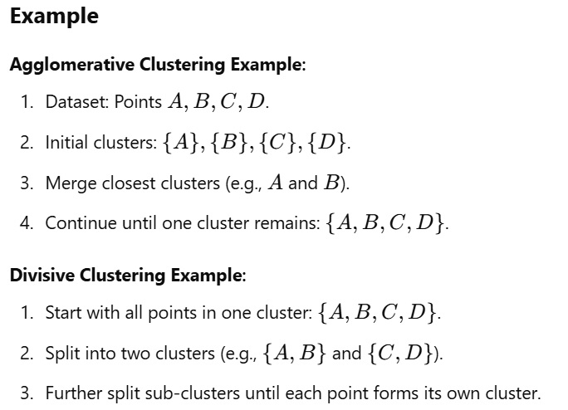

Slide 17
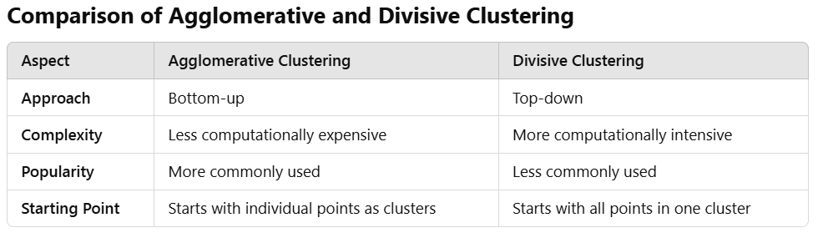
n

Slide 18
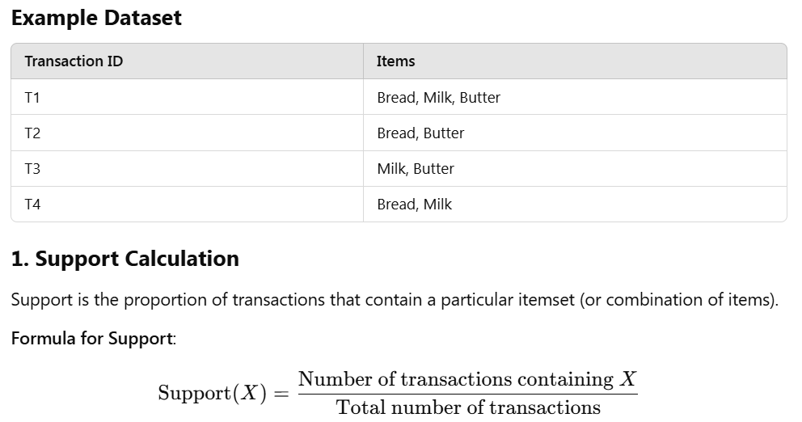
Frequent Pattern Mining
It is a data mining technique to discover patterns, correlations, or associations in datasets.
It identifies sets of items, sequences, or events that occur frequently together in transactional databases.

Slide 19
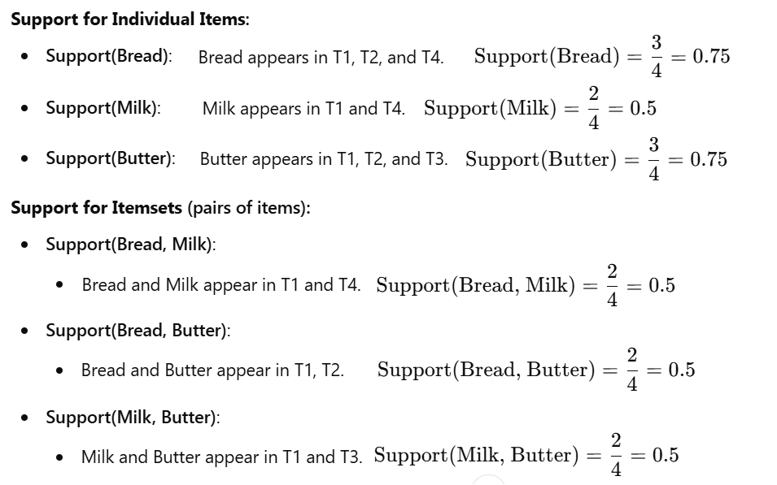

Slide 20
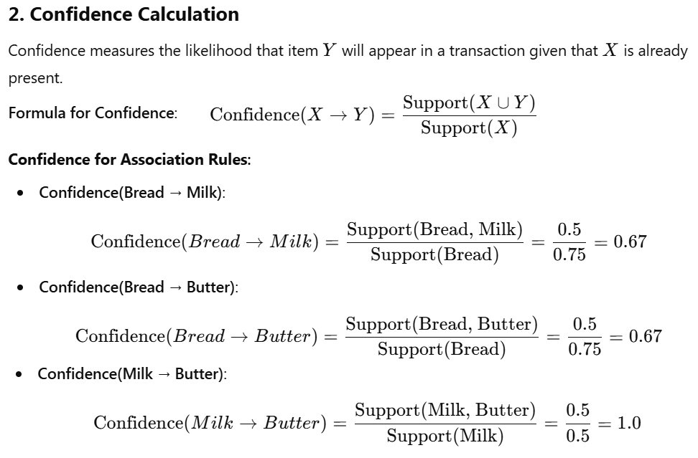

Slide 21
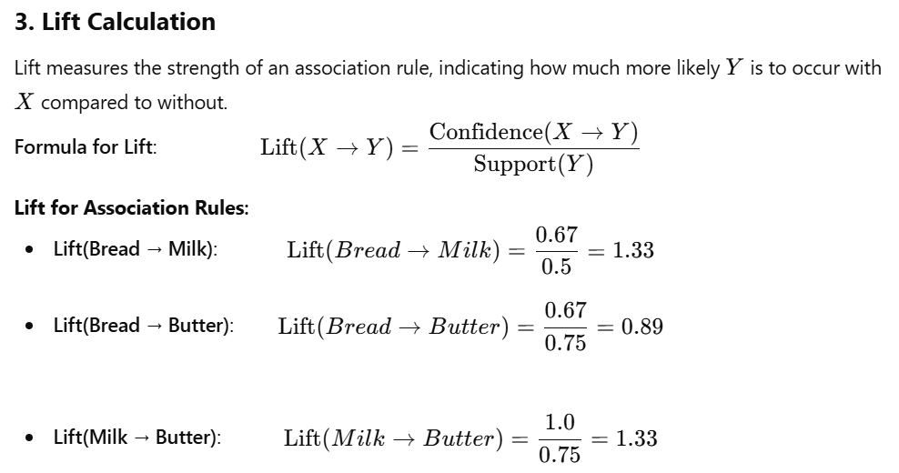

Slide 22
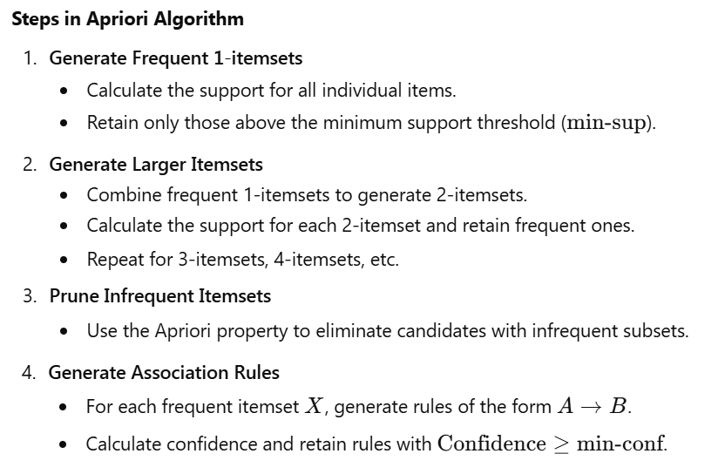
Apriori Algorithm
The Apriori Algorithm is an iterative method used to identify frequent itemsets in a dataset and generate association rules.

Slide 23
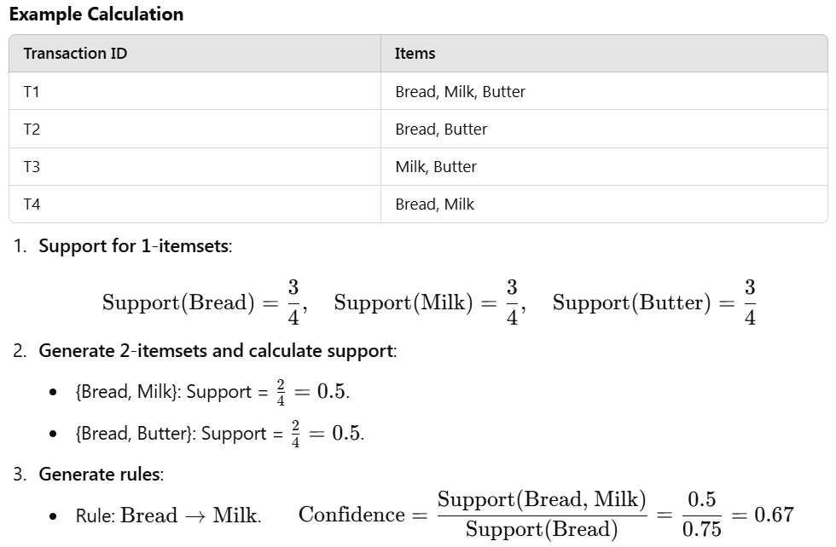

Slide 24
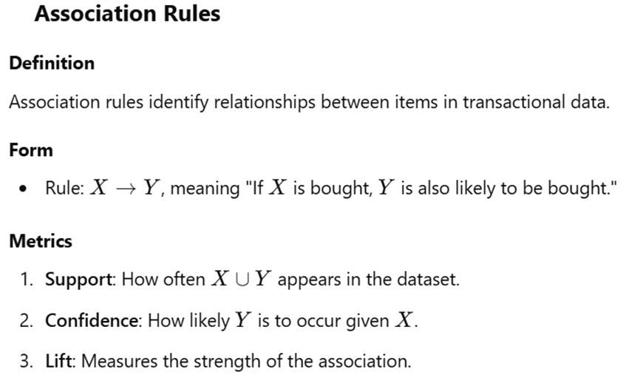

Slide 25
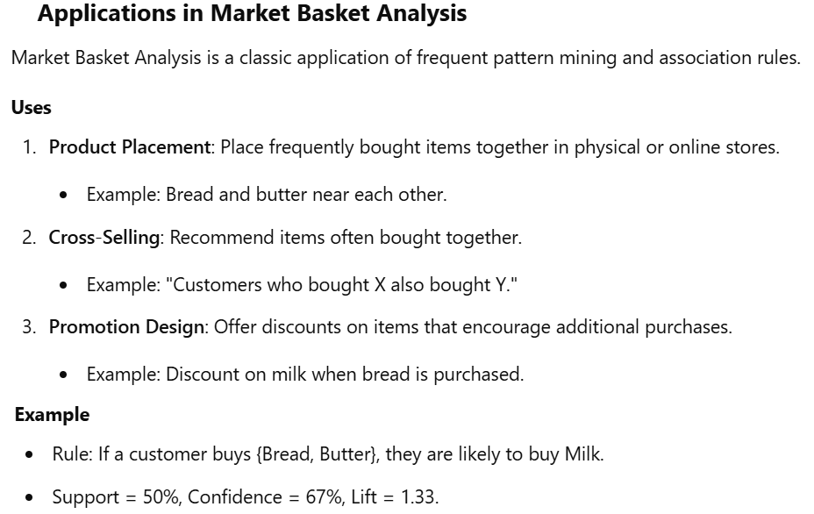

Slide 26
Dimensionality Reduction
Dimensionality reduction is the process of reducing the number of input variables (features) in a dataset.
It is helpful in improving the efficiency of ML algorithms, reducing computational costs, and preventing overfitting.
Why Dimensionality Reduction?
Reduces Computational Complexity: Decreases the number of features, speeding up training.
Removes Redundancy: Eliminates correlated features.
Improves Visualization: Reduces the data to 2D or 3D for better interpretation.
Prevents Overfitting: Less chance of fitting the model to noise in high-dimensional data.
Common Techniques:
Principal Component Analysis (PCA)
Linear Discriminant Analysis (LDA)

